Slide 1


Figures for Metis documentation

Slide 2
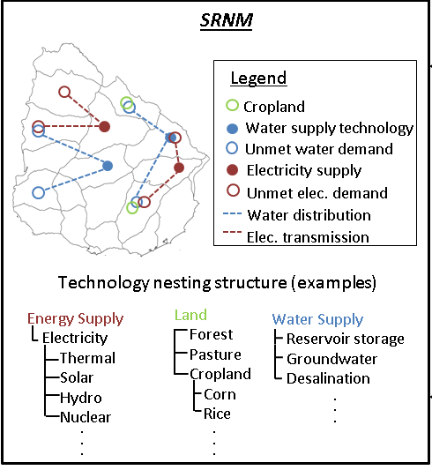
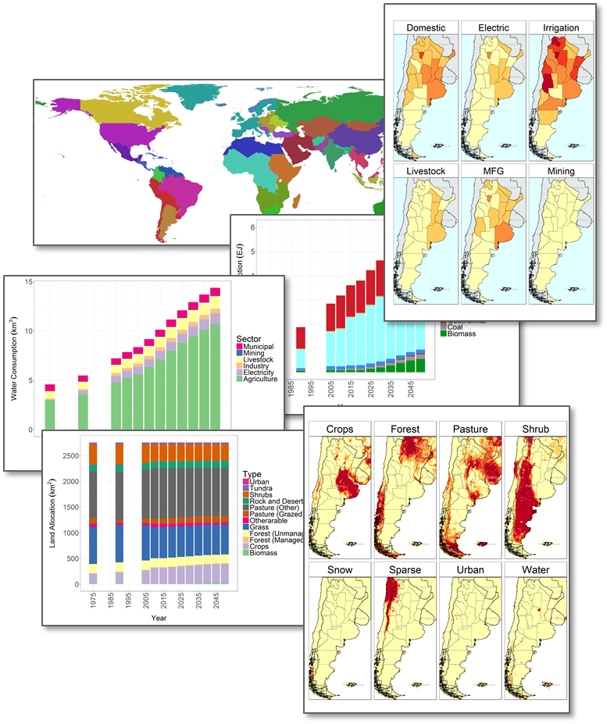
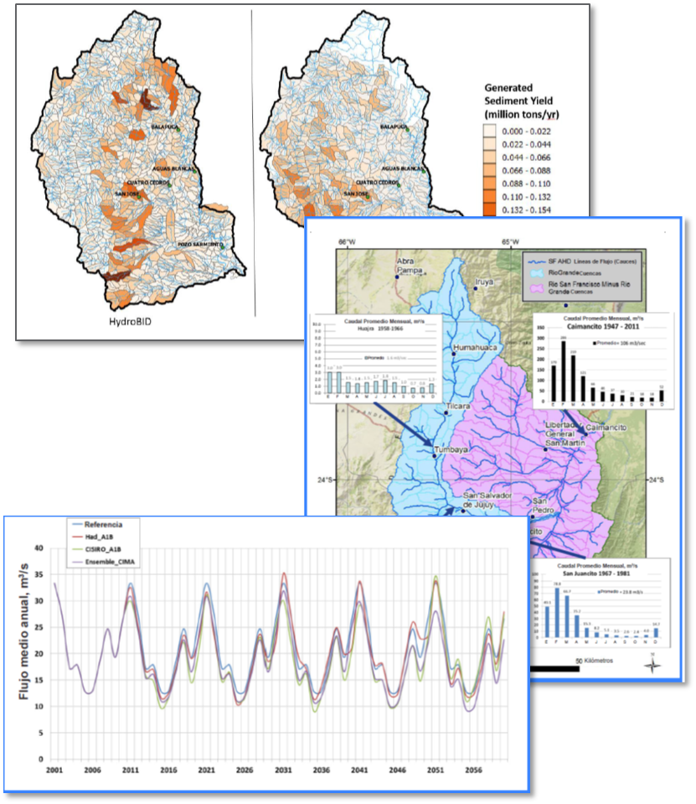
Integrated Assessment Modeling Ecosystems
(e.g., GCAM)
Aggregated Regional Nexus Model
(Metis)
High-Fidelity Sectoral Models
(e.g., HydroBID)
Metis

Slide 3
Metis 1.0
Metis 2.0
Metis 3.0
Metis x
Visualize
Link
Build
…
Charts
Links – I/O
Infrastructure
Maps
Calibration
Transfers
Spatial Aggregation
Forecasting

Slide 4
Modules
Key Functions
Descriptions
metis.chartsProcess.R
metis.chart.R
Create charts for each region, scenario
Create diff-plots to compare scenarios
Create combined plots to compare regions
Charts
metis.boundaries
metis.mapsProcess.R
metis.map.R
Create maps showing regional and sub-regional boundaries
Create raster and polygon maps to show parameters
Create diff-maps to compare scenarios
Maps
Spatial Aggregation
metis.grid2poly
metis.gridByPoly
Aggregate gridded data to given boundary shapefile
Overlay grid cells over region boundaries
Get table with lat, lon and which sub-region they lie in
metis.readgcam.R
metis.prepGrid.R
Read GCAM data
Create tables for selected parameters in appropriate format
Create templates for stakeholder local data
Data Prep
metis.io.R
Analyze inter-sectoral links in Input/Output Tables
Produce Sankey diagrams showing inter-sectoral flows
Produce A matrices showing inter-sectoral intensities.
IO

Slide 5
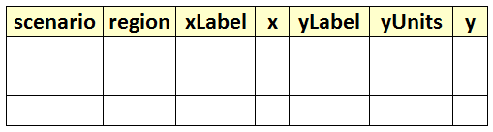
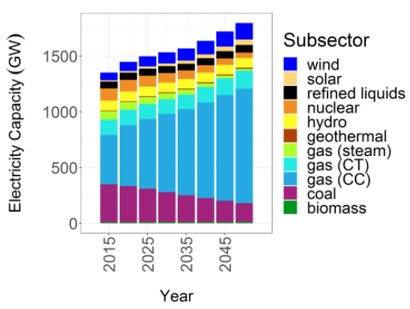
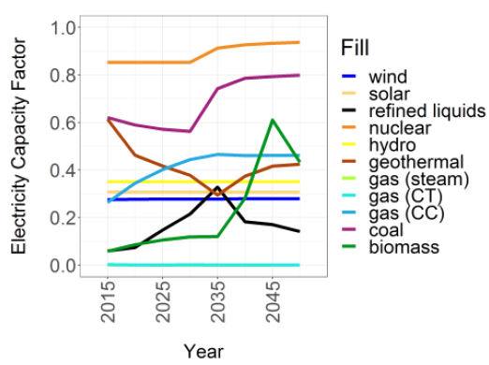
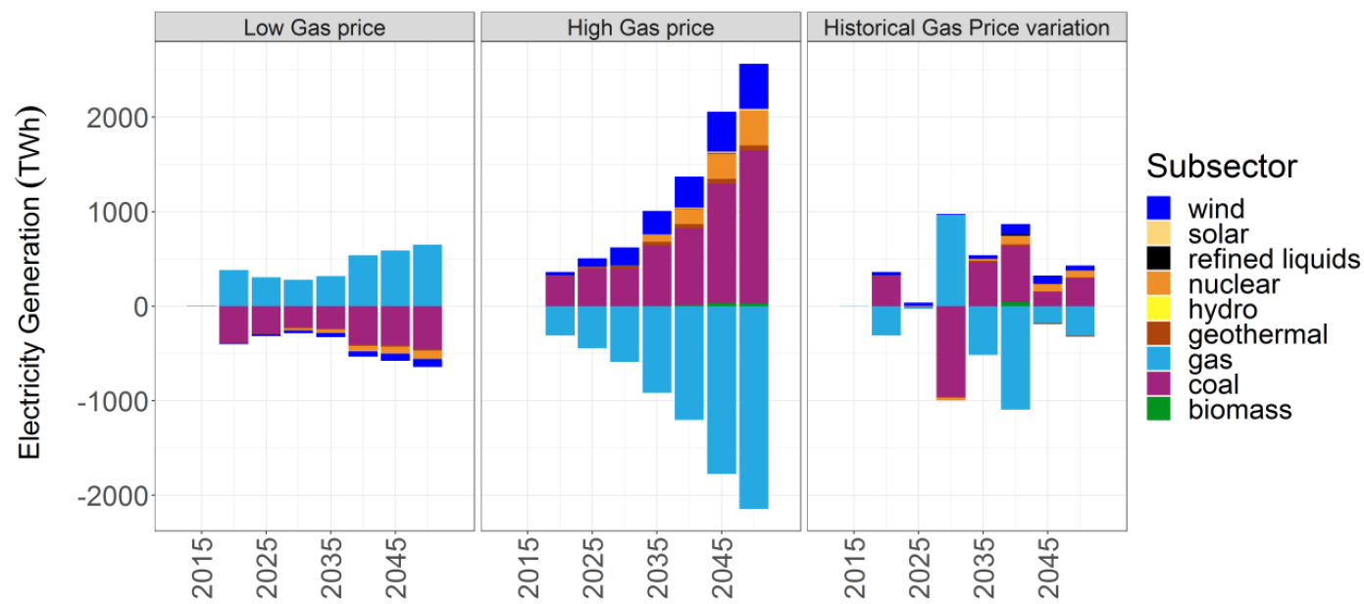
Standardized Tables
1. Default Values
2. Blank Template for users
GCAM database
Query File
metis.readgcam.R
Any Standardized Table
Charts
metis.chartsProcess.R
metis.chart.R

Slide 6
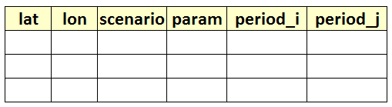
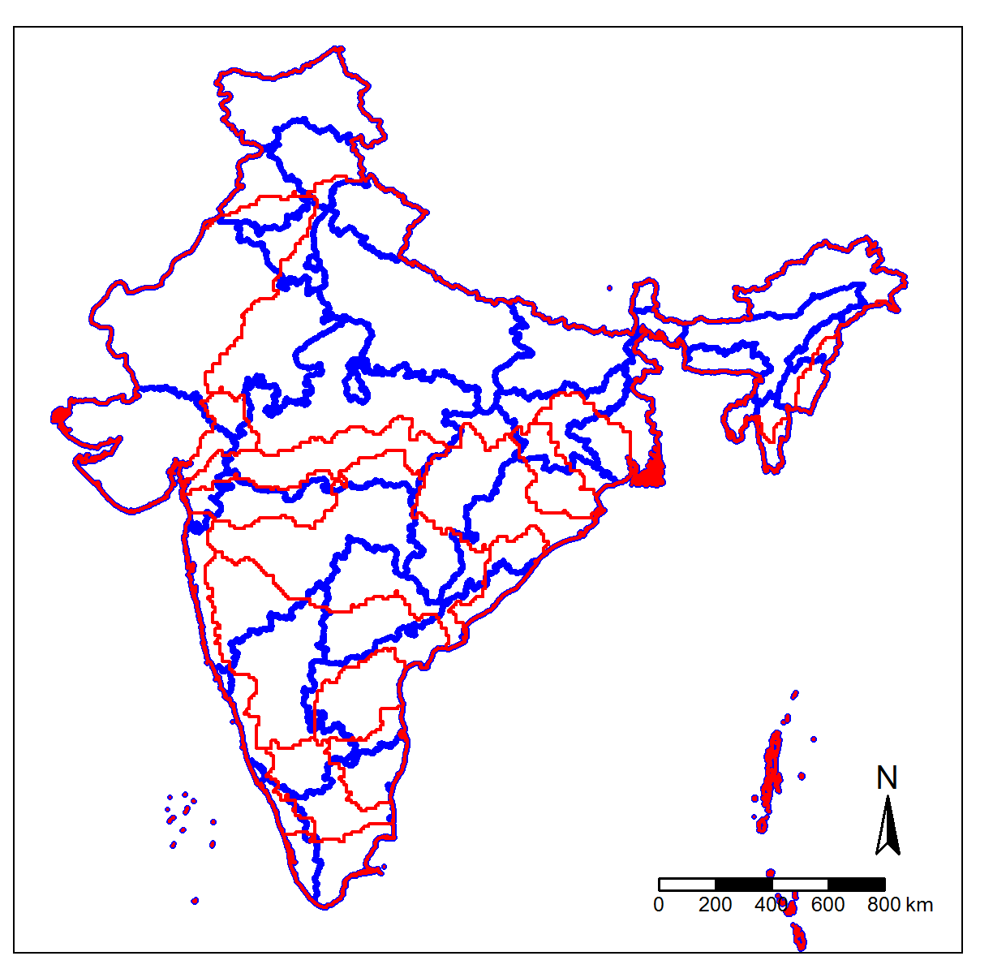
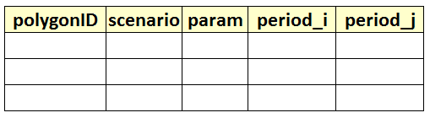
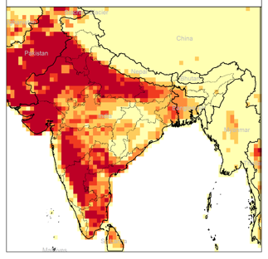
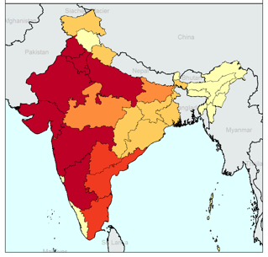
Standardized Grid Tables
1. Default Values
2. Blank Template for users
Raw gridded data
metis.prepGrid.R
Any Standardized Grid Table
Any Shapefile
Standardized Polygon Tables
metis.boundaries.R metis.grid2poly.R
1. Default Values
2. Blank Template for users
Any Standardized Polygon Table
Polygon Shapefile
Maps
1. Gridded
2. Polygons
metis.mapsProcess.R
metis.maps.R

Slide 7
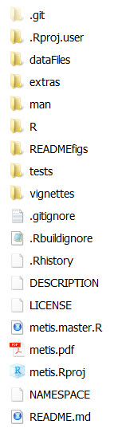
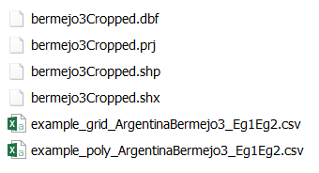
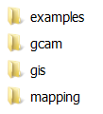
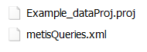
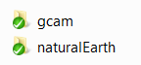
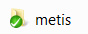
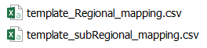
Notes:
Installation Guide

Slide 8
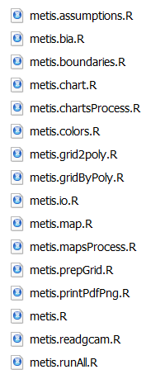

Slide 9
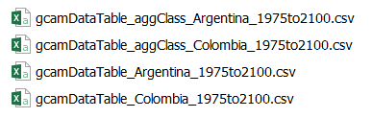
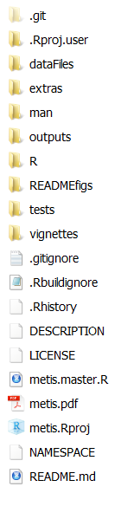
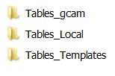
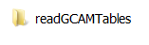
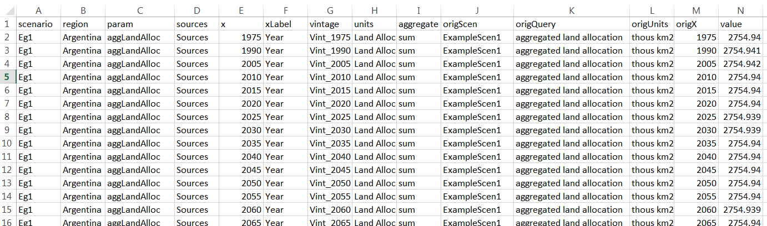
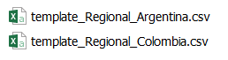
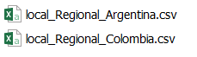
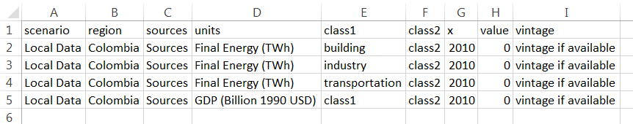
Not created automatically. Need to Add this file after getting data from local stakeholders
Notes:
Installation Guide

Slide 10
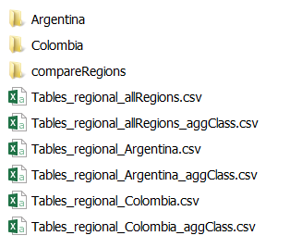
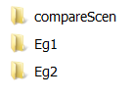
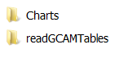
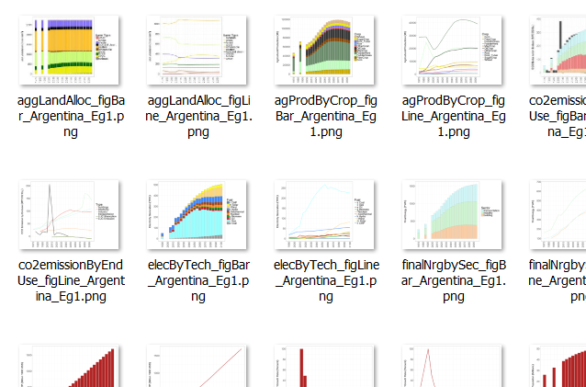
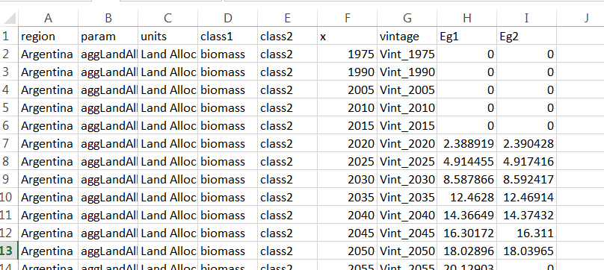
All figures are based on data from these tables
Notes:
Installation Guide

Slide 11
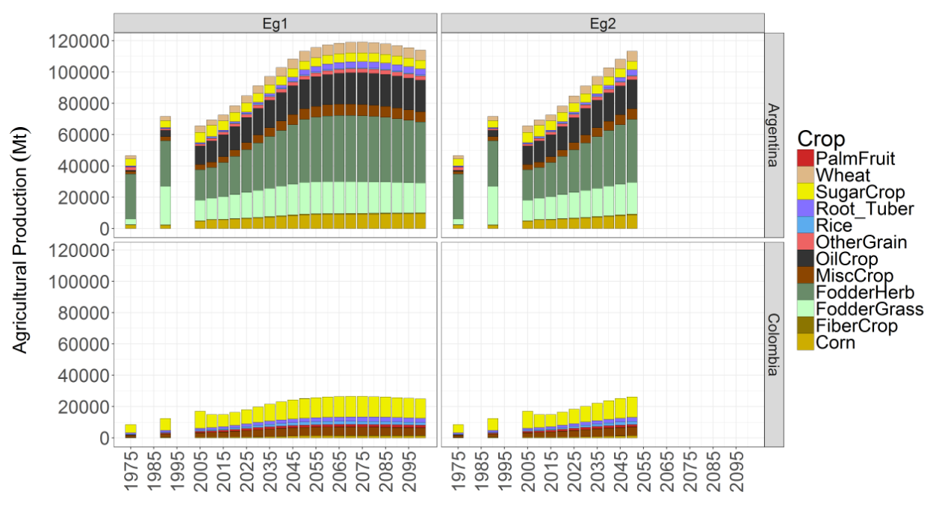
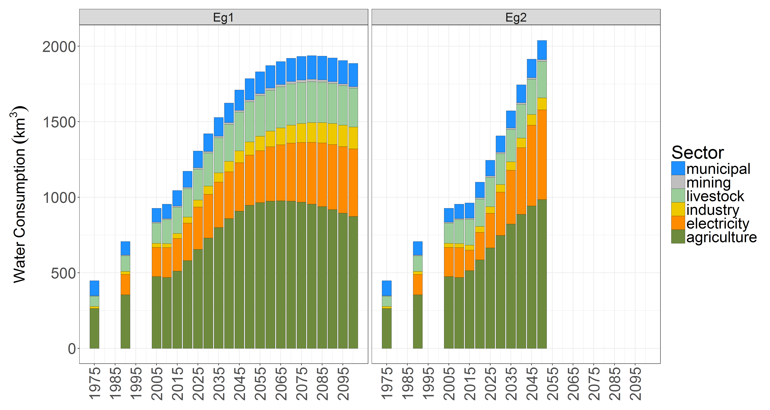
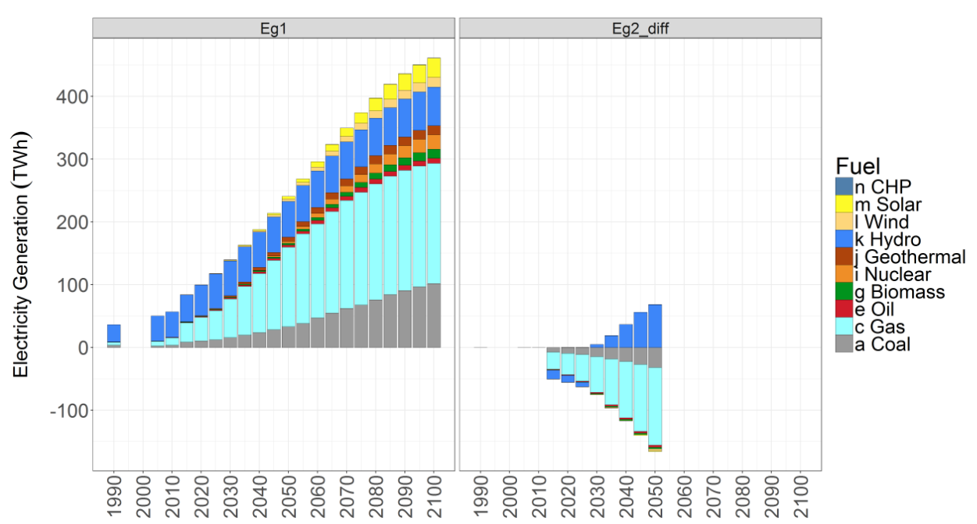
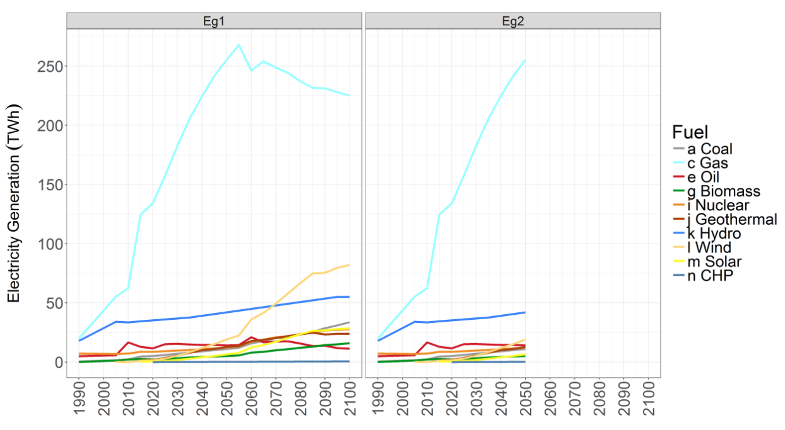
Compare Regions & scenarios
Compare Scenarios
Diff Charts
Line Charts
Notes:
Installation Guide

Slide 12
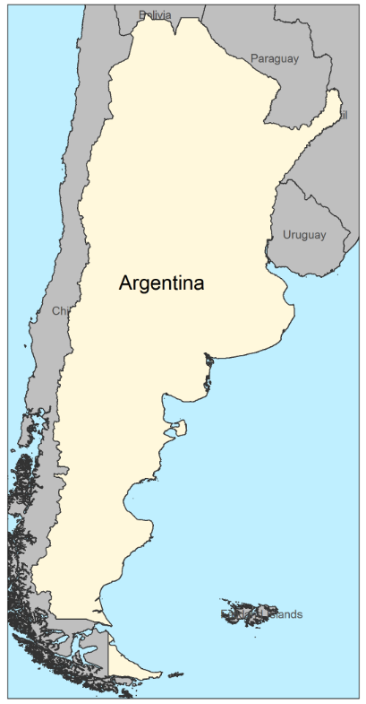
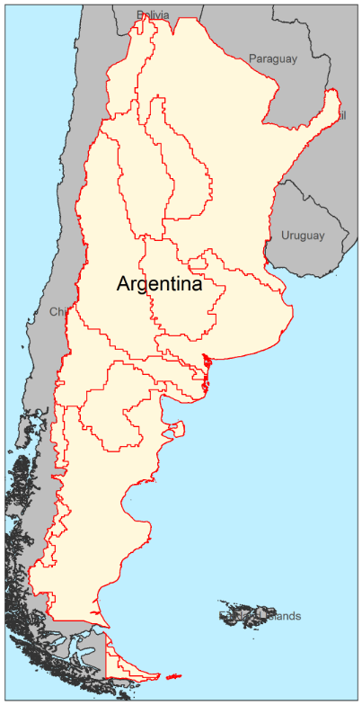
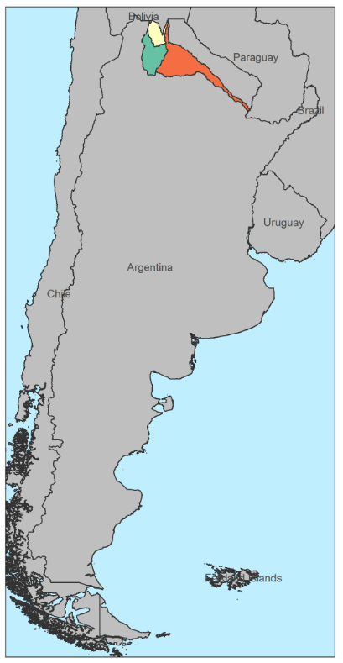
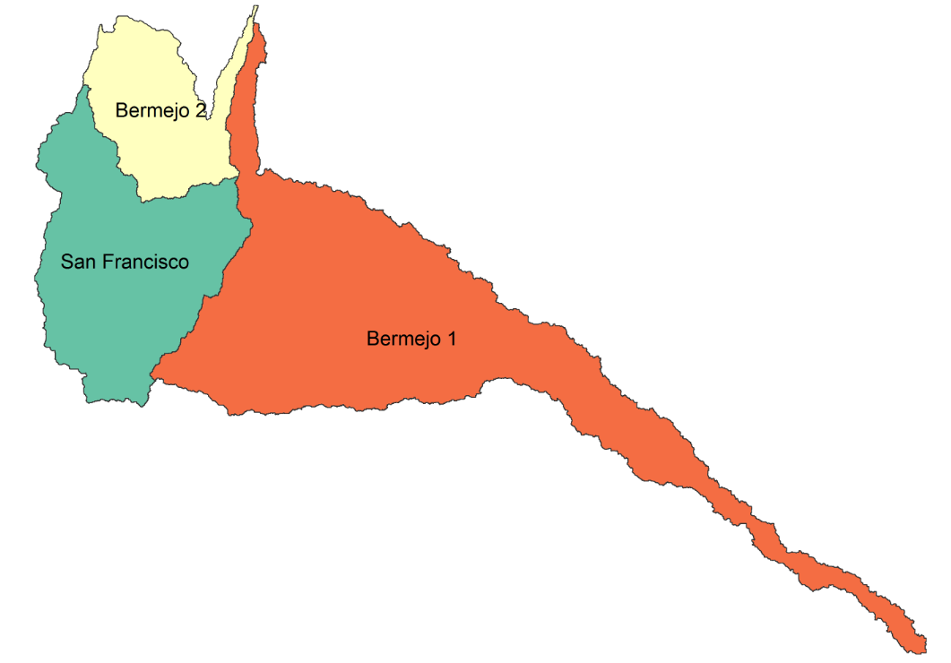
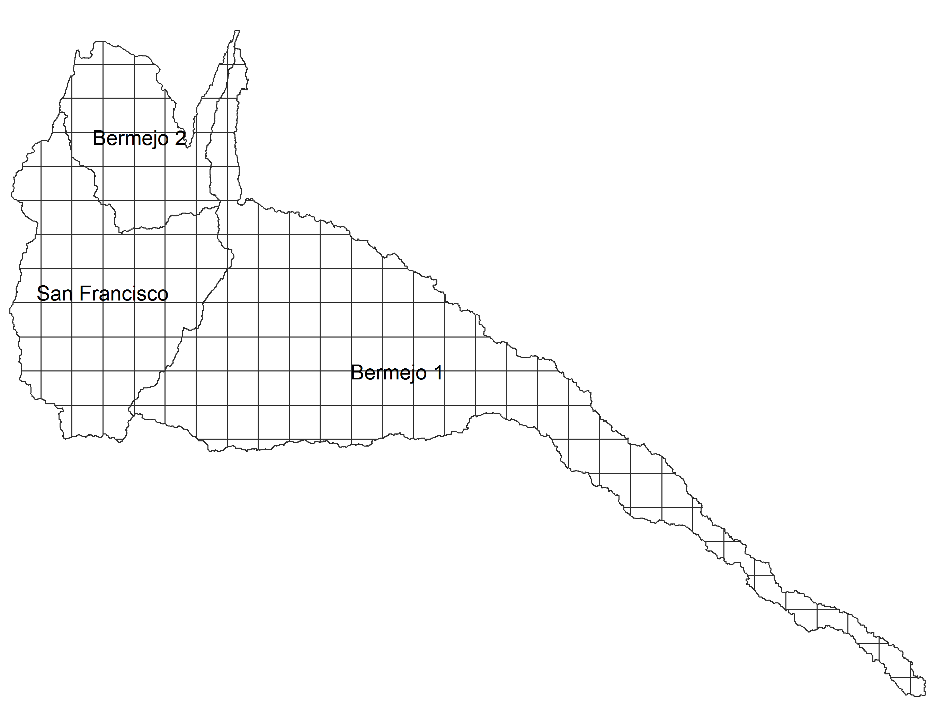
Regional highlight
Overlap Lines
Sub-regions Extended
Sub-regions Close-up
Sub-regions vs Grid Size

Slide 13
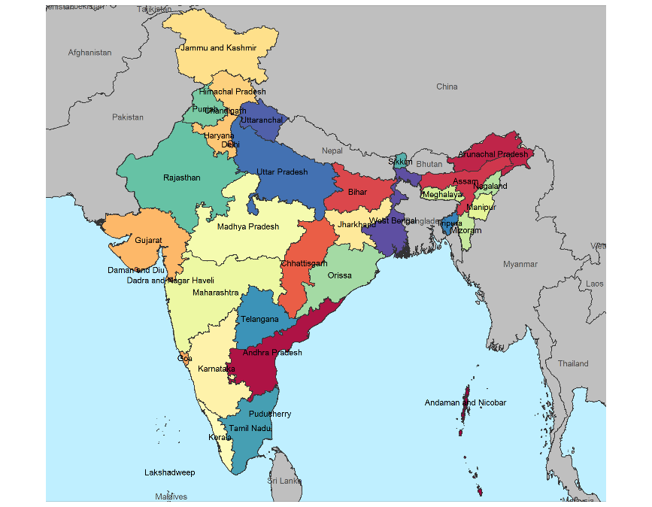
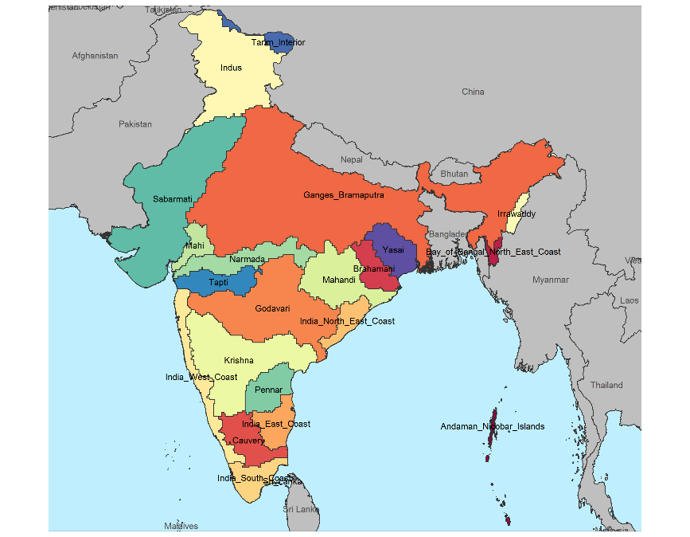
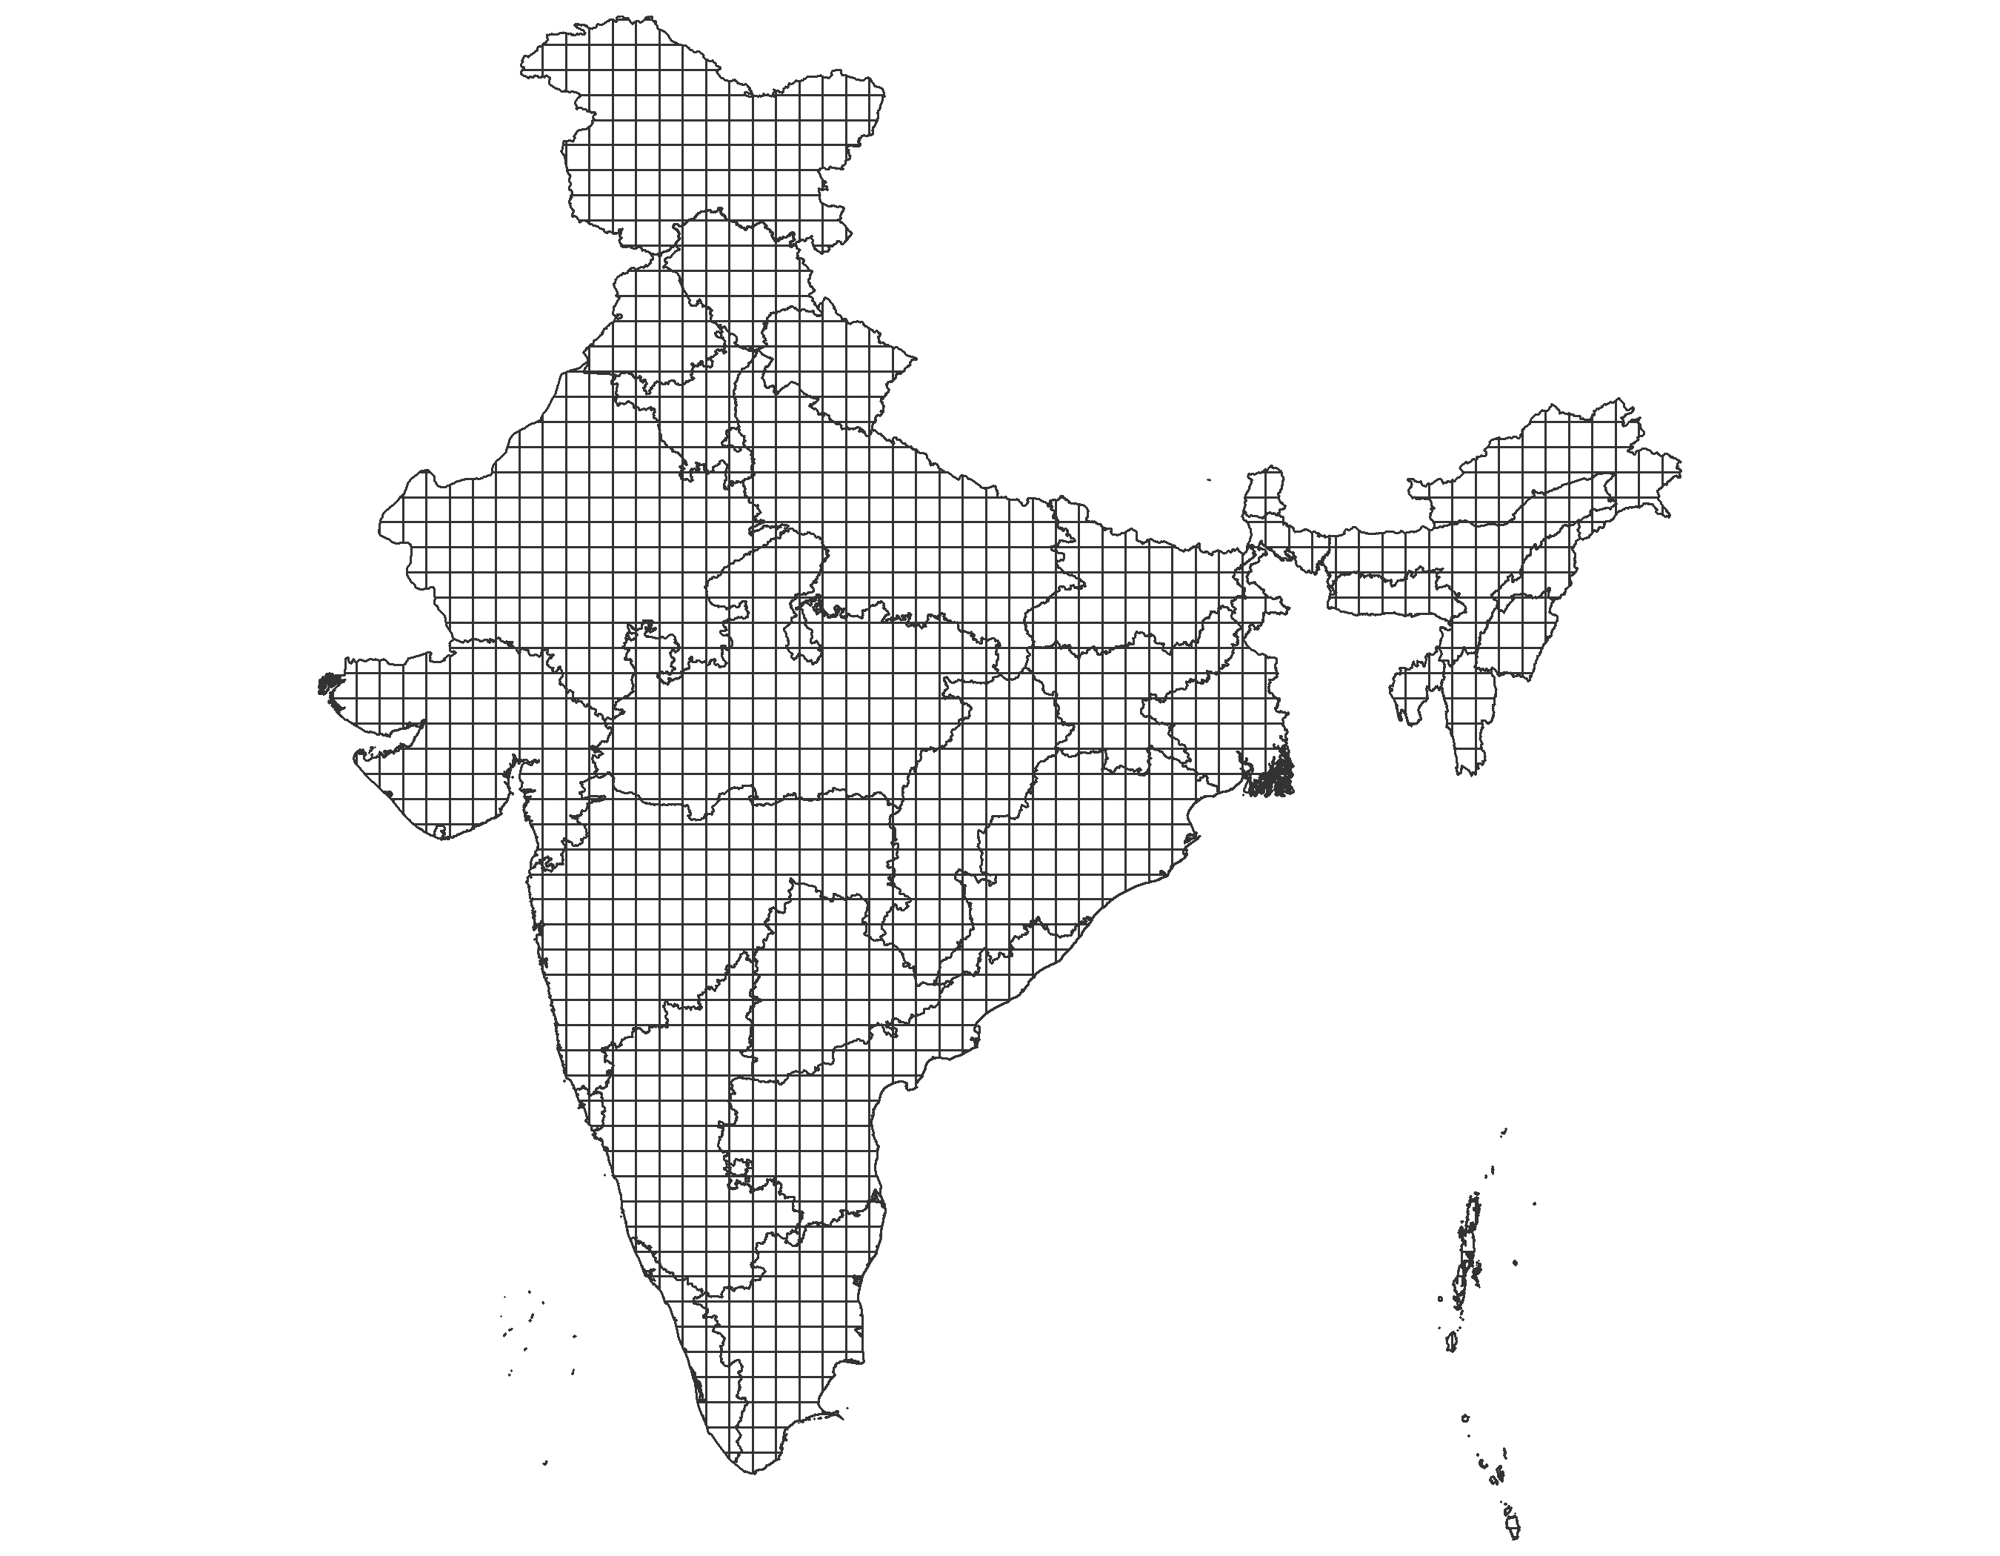
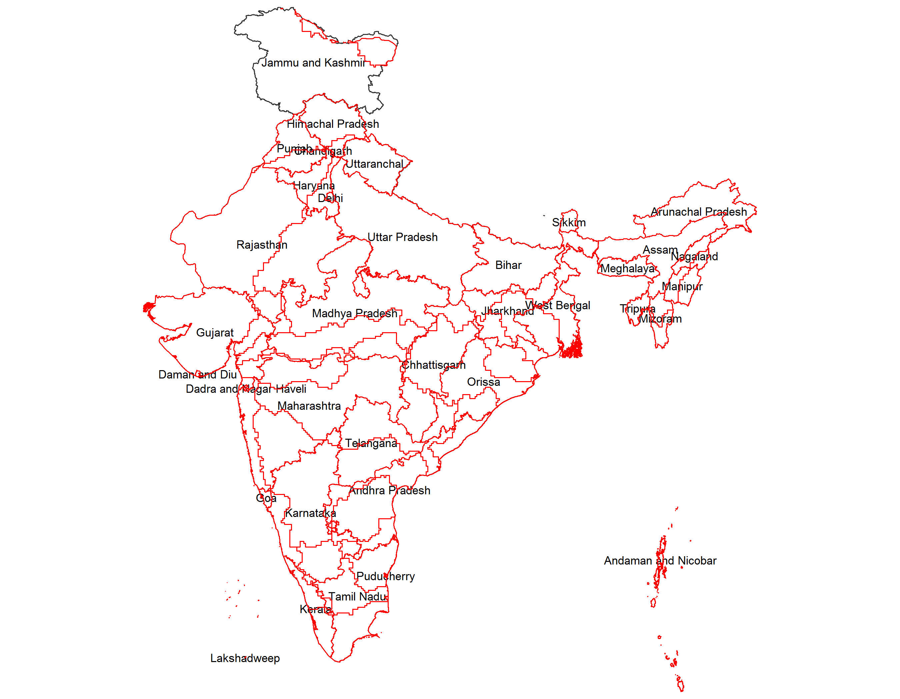
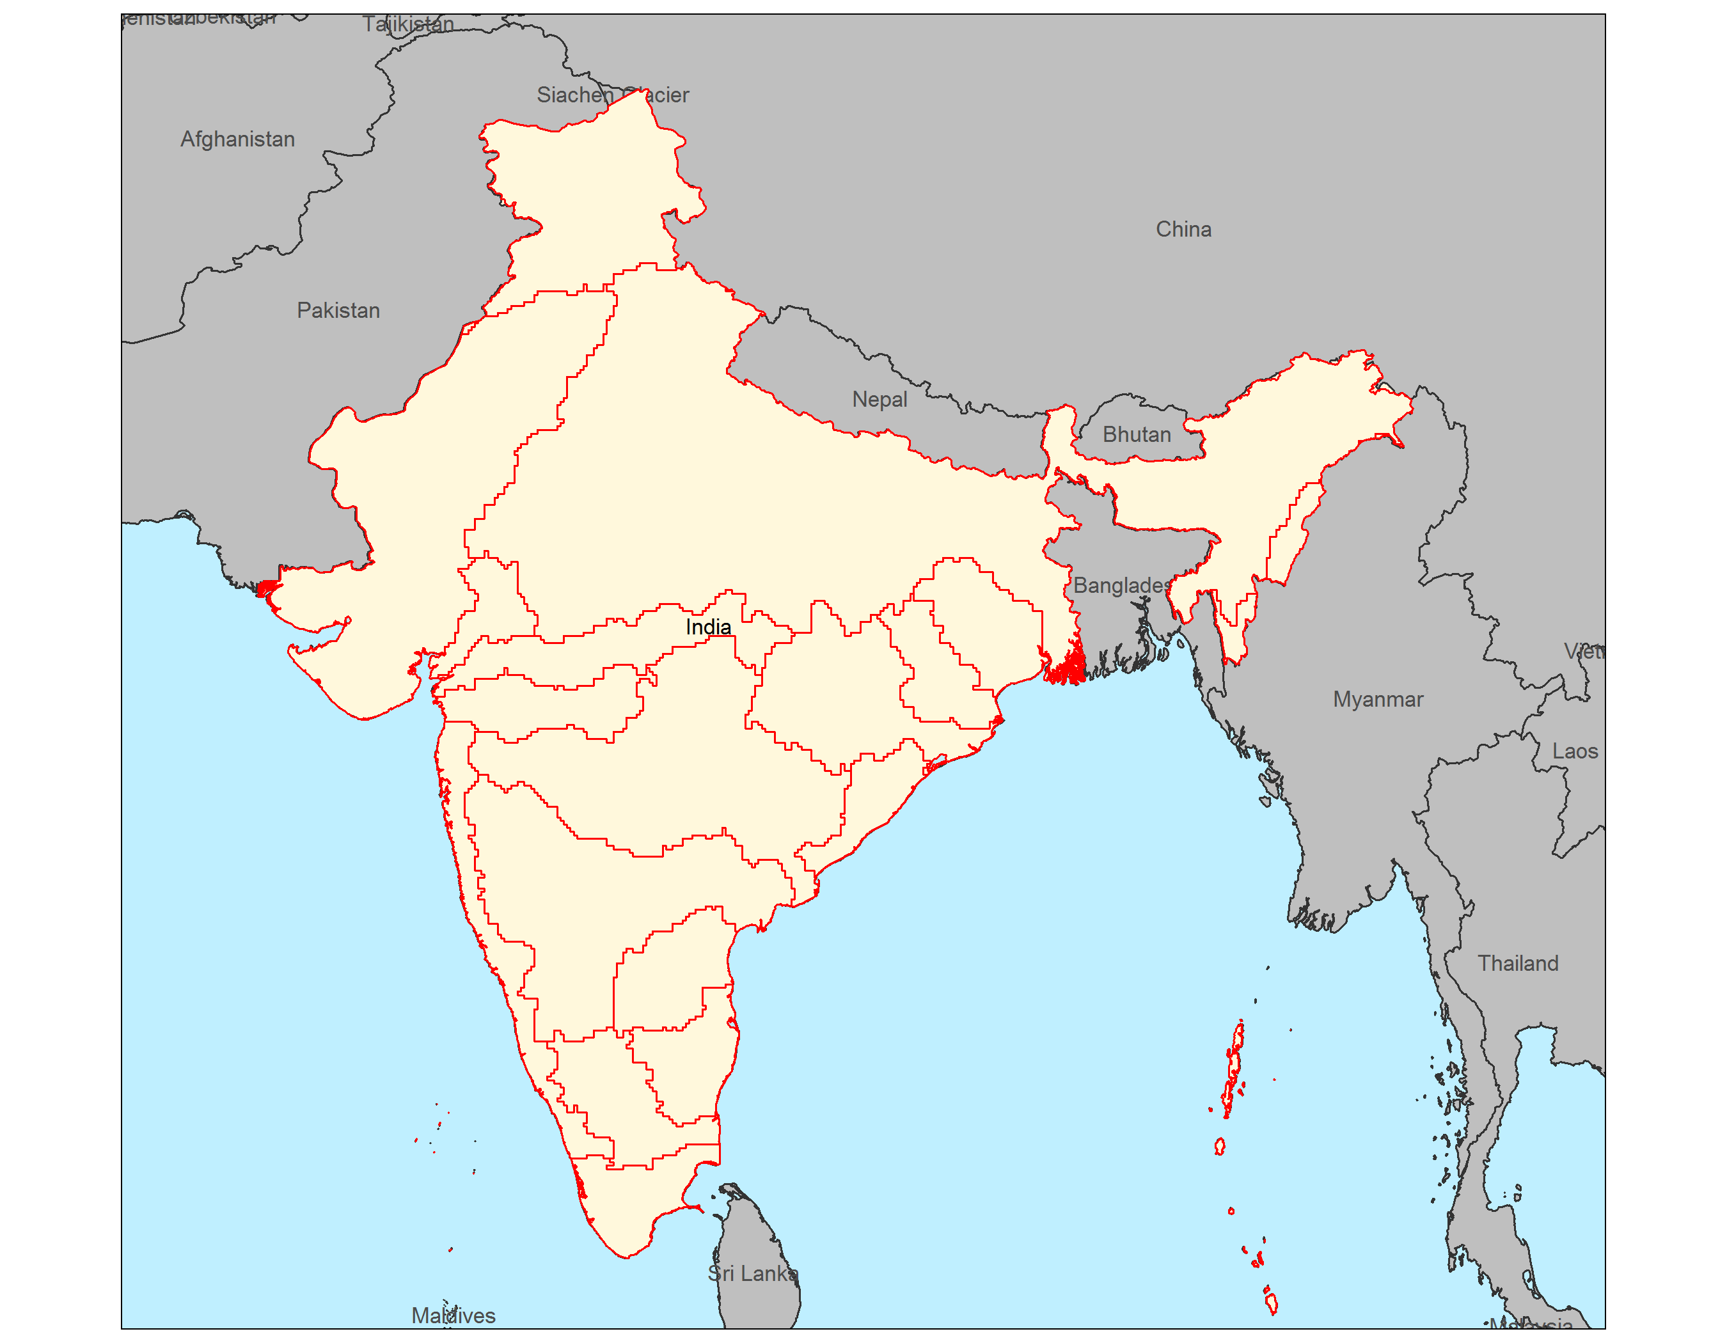
States
Basins
Visualize Grid Size
Overlap – States vs. Basin
Visualize Boundaries

Slide 14
Example
Grid Cell
Values
Raster Area
Weights
Polygon Area
Weights
90%
10%
1000
60%
50%
50%
100
30%
20%
80%
10
10%
For Vol (e.g. m³) – Sum of Raster Area Weighted
For Depth (e.g. mm) – Mean of Polygon Area Weighted
1000 x 0.9
1000 x 0.6
100 x 0.5
100 x 0.3
10 x 0.2
10 x 0.1
Sum = 900+50+2 = 952 m³
Mean = (600+30+1)/3 = 631/3 = 210.33 mm

Slide 15
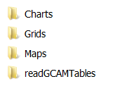
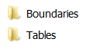
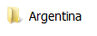




Slide 16






Slide 17



Free Scale
kmeans
Equal breaks

Slide 18





Metis IO Table Example |  | Demand Sectors
 |  | Electricity | Water | Agriculture | Industry | Residential | Other Sectors | Total
Supply Sectors | Electricity (TWh) | - | 15 | 5 | 100 | 70 | 30 | 220
 | Water (km³) | 10 | - | 200 | 10 | 80 | 100 | 400
 | Agriculture (Mt) | 5 | - | - | 10 | 5 | 20 | 40
Nexus flows
Other flows
Total
$$Zi$$
$$+$$
$$Fi$$
$$=$$
$$x$$

Slide 19







Metis IO Table Example |  | Demand Sectors
 |  | Electricity | Water | Agriculture | Industry | Residential | Other Sectors | Total
Supply Sectors | Electricity (TWh) | - | 15 | 5 | 100 | 70 | 30 | 220
 | Water (km³) | 10 | - | 200 | 10 | 80 | 100 | 400
 | Agriculture (Mt) | 5 | - | - | 10 | 5 | 20 | 40
Nexus flows
Other flows
Total
$$Zi$$
$$+$$
$$Fi$$
$$=$$
$$x$$
Intensity Matrix
Leontief Inverse
$$A$$
$$L$$

Slide 20



Slide 21
Ref – GCM – RCP – Hist Mean
Ref – GCM – RCP – Fut Mean
All –GCM-RCP – Hist Mean
All-GCM-RCP – Fut MEan
Maps_GCM_RCP_SSP
Pol 1
 | GCM | GCM
RCP | Map – Anim All years Each Param Class | Map – Mean Hist, Future Each Param Class
RCP | Map – Anim Diff year-meanhist Diff year-meanfut | Map – Static Each Diff year-meanhist Diff year-meanfut
SSP1
Raster
Pol 2
Country 1
SSP2
Sub-basin
Diff Pol1-Pol2
Country 2
SSP..
States
Pol 1
 | GCM | GCM
RCP | Line Chart Parm vs year SSP col
RCP
SSP Comp
Pol 2
Diff Pol1-Pol2

